Slide 1
Query Processing
Query processing: include translation of high level queries into low level expression that can be used at the physical level of the file system, query optimization and actual execution of the query to get the result .
Query optimization : it is a process in which multiple query execution pans for satisfying a query are examined and a most efficient query plan is identified for execution.

Slide 2
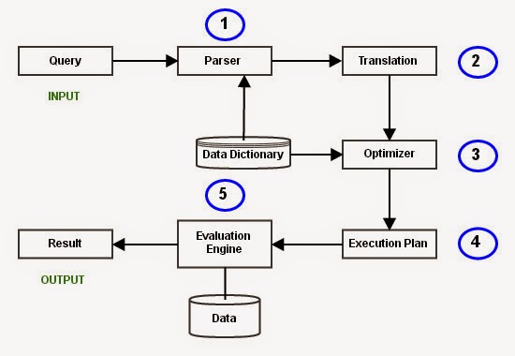
Query Processing

Slide 3
Query Processing
Employee(Eno, Ename, Phone)
Proj_Assigned (Eno, Proj_No, Role, DOP)
where,
Eno is Employee number,
Ename is Employee name,
Proj_No is Project Number in which an employee is assigned,
Role is the role of an employee in a project,
DOP is duration of the project in months.
With this information, let us write a query to find the list of all employees who are working in a project which is more than 10 months old.
SELECT Ename
FROM Employee, Proj_Assigned
WHERE Employee.Eno = Proj_Assigned.Eno AND DOP > 10;

Slide 4
Query Processing
The major steps involved in query processing are
Step 1: Parsing
In this step, the parser of the query processor module checks the syntax of the query, the user’s privileges to execute the query, the table names and attribute names, etc. The correct table names, attribute names and the privilege of the users can be taken from the system catalog (data dictionary).
Step 2: Translation
If we have written a valid query, then it is converted from high level language SQL to low level instruction in Relational Algebra.
For example, our SQL query can be converted into a Relational Algebra equivalent as follows;
π_{Ename}(σDOP>10 Λ Employee.Eno=Proj_Assigned.Eno(Employee X Prof_Assigned))

Slide 5
Query Processing
Step 3: Optimizer
Optimizer uses the statistical data stored as part of data dictionary. The statistical data are information about the size of the table, the length of records, the indexes created on the table, etc. Optimizer also checks for the conditions and conditional attributes which are parts of the query.
Step 4: Execution Plan
A query can be expressed in many ways. The query processor module, at this stage, using the information collected in step 3 to find different relational algebra expressions that are equivalent and return the result of the one which we have written already.
For our example, the query written in Relational algebra can also be written as the one given below;
π_{Ename}(Employee ⋈_{Eno} (σ_{DOP>10} (Prof_Assigned)))
So far, we have got two execution plans. Only condition is that both plans should give the same result.

Slide 6
Query Processing
Step 5: Evaluation
Though we got many execution plans constructed through statistical data, though they return same result (obvious), they differ in terms of Time consumption to execute the query, or the Space required executing the query. Hence, it is mandatory choose one plan which obviously consumes less cost.
At this stage, we choose one execution plan of the several we have developed. This Execution plan accesses data from the database to give the final result.
In our example, the second plan may be good. In the first plan, we join two relations (costly operation) then apply the condition (conditions are considered as filters) on the joined relation. This consumes more time as well as space.
In the second plan, we filter one of the tables (Proj_Assigned) and the result is joined with the Employee table. This join may need to compare less number of records. Hence, the second plan is the best (with the information known, not always).

Slide 7
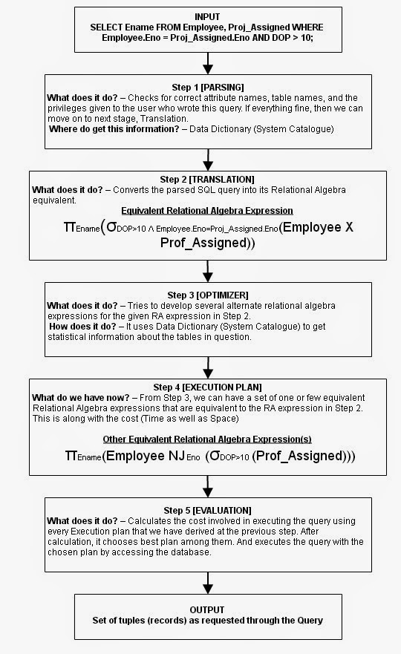
Output: The final result is shown to the user.

Slide 8
Introduction to Query Optimization
One of the most important tasks of a DBMS
The same query can be expressed in many ways.
It makes it easy to write queries.
A given query can be evaluated in many ways, some cheaper than others (orders of magnitude difference).
Good performance relies greatly in the quality of the query optimizer.

Slide 9
Introduction to query optimization
Query optimization :it is a process in which multiple query execution pans for satisfying a query are examined and a most efficient query plan is identified for execution.
Optimizing such a relational algebra expression involves two basic steps:
• Enumerating alternative plans for evaluating the expression. Typically, an optimizer considers a subset of all possible plans because the number of possible plans is very large.
• Estimating the cost of each enumerated plan and choosing the plan with the lowest estimated cost.

Slide 10
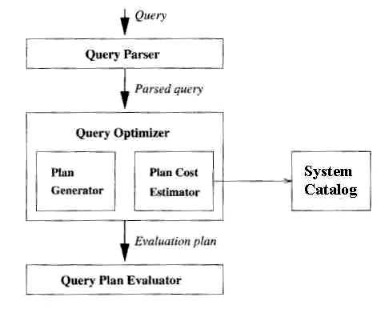
Query Parsing optimization and execution

Slide 11
Optimizing Queries
Queries can be seen as σ, π, ./ algebra expression.
Optimizing an expression involves two basic steps:
– Enumerating alternative plans for evaluating the expression .
– Estimating the cost of each plan .
– Choosing the plan with the lowest estimated cost

Slide 12
Query Evaluation Plans
A query evaluation plan (or simply plan) consists of an extended relational algebra tree, with additional annotations at each node indicating:
the access methods to use for each table .
the implementation method.
SELECT S.name FROM Reserves R, Sailors R WHERE R.sid = S.sid AND R.bid = 100 AND S.rating > 5 .

Slide 13
Query Evaluation Plan...
SELECT S.name FROM Reserves R, Sailors R WHERE R.sid = S.sid AND R.bid = 100 AND S.rating > 5
✥ This query can be expressed as:
πsname(σbid=100∧rating>5 (Reserves dasid=sid Sailors))
πsname
σbid=100∧rating>5 dasid=sid
Reserves
Sailors

Slide 14
Query Evaluation Plan...
✥ We also have to decide on the implementation of each operator
πsname
(On-the-fly)
σbid=100∧rating>5
(On-the-fly)
dasid=sid
(Simple nested loops)
(File Scan) Reserves Sailors (File Scan)
✥ This tree is a query evaluation plan for the SELECT
✥ Convention: the outer table is the left child of a join

Slide 15
Multi Operator Queries
✥ When the query involves several operators, sometimes the result of one is pipelined into the next
✥ In this case, no temporary relation is written to disk (materialized)
✥ The result is fed to the next operator as soon as it is available
✥ It is cheaper!
✥ When the input table to a unary operator is pipelined into it, we say it is applied on-the-fly

Slide 16
Pipelining
da
Results tuples of first join are pipelined into join with C
da
C
A
✥ Pipelining is a control strategy
B
✥ Results are produce one page at a time, used and then discarded

Slide 17
The Iterator Interface
Once the evaluation plan is decided, it is executed by calling the operators in some order (possibly interleaved)
Each operator has one or more inputs
Passes result tuples to the next operator
Materialization is usually done at the input stage of an operator
When is it needed to materialize?
Internally an operator has a uniform iterator interface:
open, get next, close
It encapsulates materialization or on-the-fly processing
It also encapsulates use of indexes

Slide 18
System Catalog in a relational DBMS
System catalog is a group of tables,& contain a metadata & system catalog is a system create database.
in a relational DBMS, every file contains either the tuples in a table entries in an index. The collection of file corresponding to users tables and indexes represents the data in the database.
A relational DBMS maintains information about every table and index that it contains. The descriptive information is itself stored in a collection of special tables called the catalog tables. The catalog tables are also called the data dictionary, the system catalog, or simply the catalog.

Slide 19
System Catalog in a relational DBMS
Information in the Catalog .
what is stored in the system catalog and the following information about individual tables, indexes, and views:
For each table: - Its table name, the file name (or some identifier), and the file structure (e.g., heap file) of the file in which it is stored.
- The attribute name and type of each of its attributes.
- The index name of each index on the table. - The integrity constmints.
For example emp-table
Emp-id,emp-name,emp-dept.

Slide 20
System Catalog in a relational DBMS
For each index: - index name, structure, search key attribute.
• For each view: - Its view name and definition.
Catalog contain information & autherization catalog table describe all the tables in the database include catalog tables themselves whenever DBMS needs to find the schema of a catalog tables the code that retrive this information must be handled specially.

Slide 21
System Catalog in a relational DBMS
The following information is commonly stored:
Cardinality: The number of tuples NTaplcs(R) for each table R.
• Size: The number of pages NPages(R) for each table R.
• Index Cardinality: The number of distinct key values NKeys(I) for each index I.
• Index Size: The number of pages INPages(I) for each index I. (For a B+ tree index I, we take INPagcs to be the number of leaf pages.)

Slide 22
System Catalog in a relational DBMS
Index Height: The number of nonleaf levels IHe'ight(I) for each tree index I.
• Index Range: The minimum present key value ILow(I) and the maximum present key value INigh(I) for each index I.

Slide 23
System Catalog in a relational DBMS
A relational DBMS is that the system catalog is itself a collection of tables. For example, we might store information about the attributes of tables in a catalog table called Attribute_Cat.
Attribute_Cat( attname: string, relname: string, type: string, position: integer)

Slide 24
Query Block
A query block is an sql with no nesting & exctly one SELECT clause & one FROM clause & at most one WHERE clause GROUP BY clause & HAVING clause.

Slide 25
EMP
Emp_id | Emp_name
1 | Ram
2 | Shyam
3 | Ravi
4 | Rahul
5 | dev

Slide 26
DEP
Dep_id | D_name
1 | HR
2 | ACC
3 | Sales
4 | Market
5 | IT

Slide 27
Account
A_id | Emp_id | Dep_id | salary
1 | 1 | 2 | 10k
2 | 2 | 1 | 24k
3 | 4 | 5 | 25k
4 | 3 | 1 | 30k
5 | 5 | 4 | 30k

Slide 28
Simple Query
Select * from salary where salary>25000
Result
A-id | Emp_id | Dep-_d | salary
4 | 3 | 1 | 30k
5 | 5 | 4 | 30k

Slide 29
Nested Query
Select E. emp_id, D. dep_name, A. salary from emp E, depD, accA Where E. emp-id=A. emp_id and D.dept_id=A.dept-id and
A. dept-id=(select dep_id from dept where d name=‘HR’)
Group by E.emp_id
Having count (emp-id)>1;
Emp_id | Dep_name | salary
3 | HR | 30k
2 | HR | 24

Slide 30
Relation Algebra
∏emp-id, dep_name, salary(
Having count(emp_id)>1(
Group by emp_id(σE emp_id= a emp-idᴧ D.dep_id=A.dep_id ᴧ
A.depid=(σd.dep_name=HR)(emp*dep*account)

Slide 31
Estimating The Cost of a Plan
For each node in the tree we must estimate the cost of performing the corresponding operation.
For each node in the tree we must estimate the size of the result ,& wheather is stored.

Slide 32
Estimating the result size
Column=value
In where condition “name”=“ABC” column=fixed value.
THE reduction factor can be approximated by
n1/KEY(1)
Column1=column2
Where emp-id=emp-id
Each key value is smaller index.
Column>value

Slide 33
Estimating the result size
Column>value
Where salary >50000 range selection
Column IN (list of values)
Where days in (mon, tues,wed) each selection eliminate at least half the candidates tuples.

